Slide 1

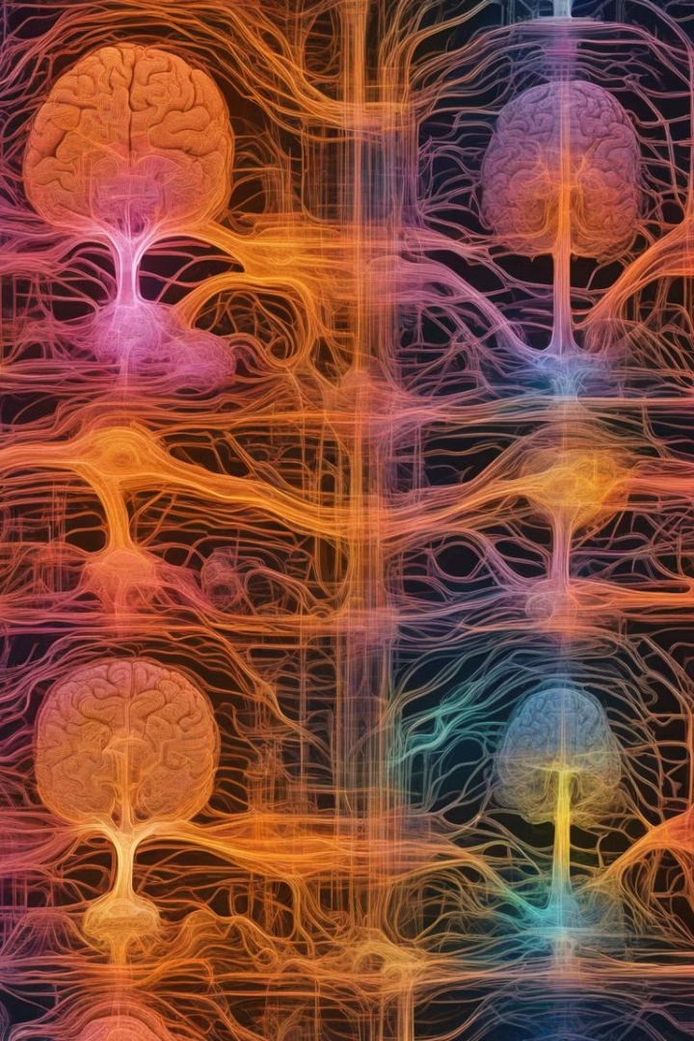
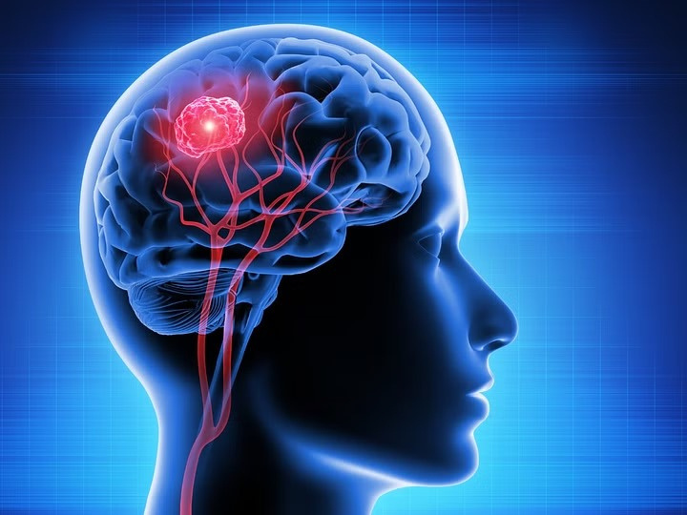
Brain Tumor Detection
Team Member :
2105429 - Abhinav Raj
2105589 - Tavishi Singh
21051512 - Sayan Mondal
21051539 - Ankan Mohanty
21051585 - Rahul Kumar Singh
21051586 - Ankita Padhy
Notes:
1

Slide 2
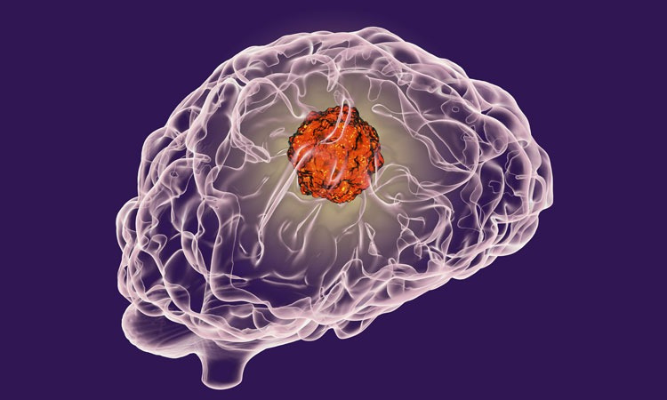
Introduction to Brain Tumors
A brain tumor is understood by the scientific community as the growth of abnormal cells in the brain, some of which can lead to cancer. The traditional method to detect brain tumors is nuclear magnetic resonance (MRI). Having the MRI images, information about the uncontrolled growth of tissue in the brain is identified. In several research articles, brain tumor detection is done through the application of Machine Learning and Deep Learning algorithms. When these systems are applied to MRI images, brain tumor prediction is done very quickly and greater accuracy helps to deliver treatment to patients. These predictions also help the radiologist to make quick decisions. In the proposed work, a set of Artificial Neural Networks (ANN) are applied in the detection of the presence of brain tumor, and its performance is analyzed through different metrics.​
Notes:
8

Slide 3
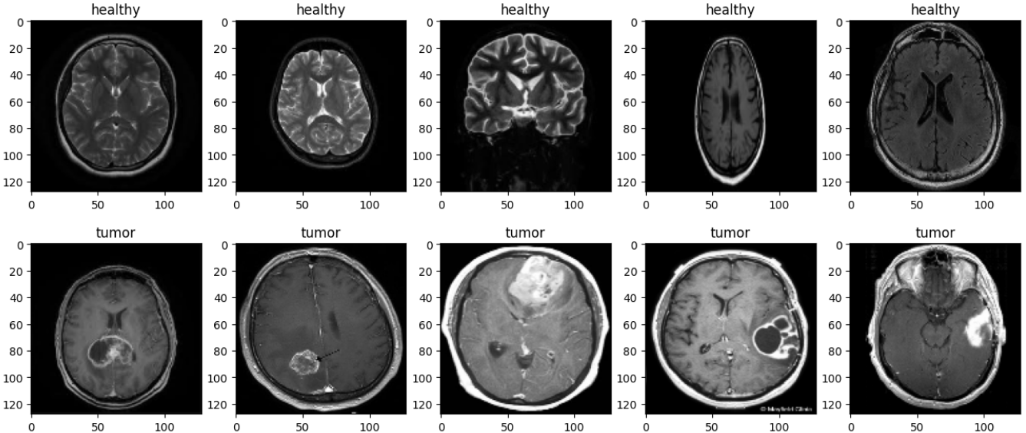

Dataset
We got our data set from Kaggle named “Brain MRI Image for Brain”, which contain Brain images labeled “tumor” for images with tumor and “healthy” for images without tumor.
Ref. https://www.kaggle.com/datasets/navoneel/brain-mri-images-for-brain-tumor-detection
Notes:
2

Slide 4

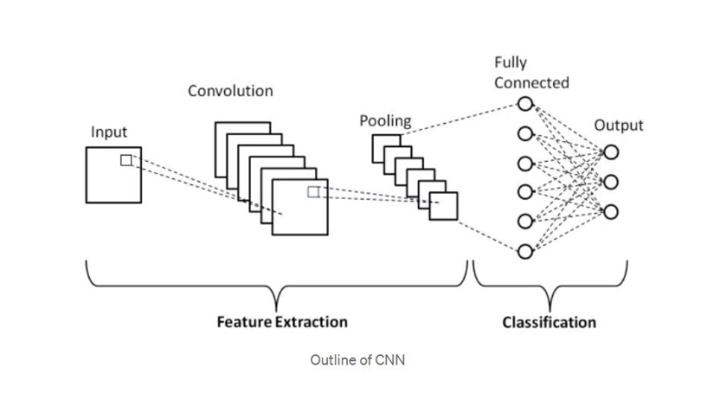
Model
Convolutional Neural Network(CNN):
CNNs are a class of Deep Neural Networks that can recognize and classify particular features from images and are widely used for analyzing visual images. Their applications range from image and video recognition, image classification, medical image analysis, computer vision and natural language processing.
Linear Neural Network:
A linear transformation takes an input vector and maps it to an output vector through a linear function. In a neural network, a linear layer takes an input tensor and transforms it into an output tensor by performing a linear operation that involves weights and biases
Notes:
3

Slide 5
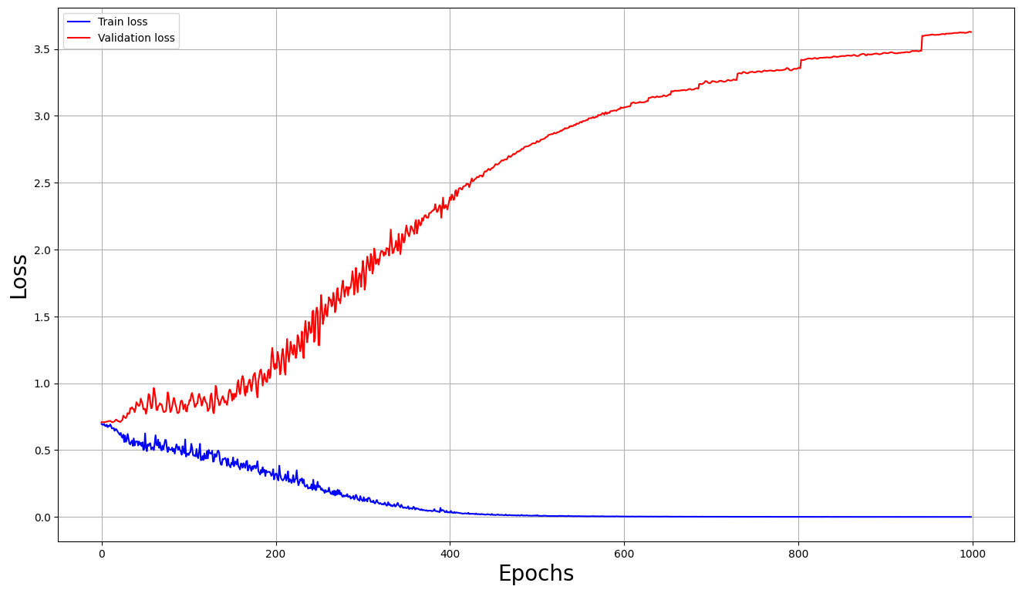
Output and Accuracy
After comparison with the original testing data the model accuracy is found to be around 0.8 i.e. 80% .
The figure correspond to the training loss and validation loss of the model and the no of epoch the model run.
Training and Validation Graph
Notes:
7

Slide 6

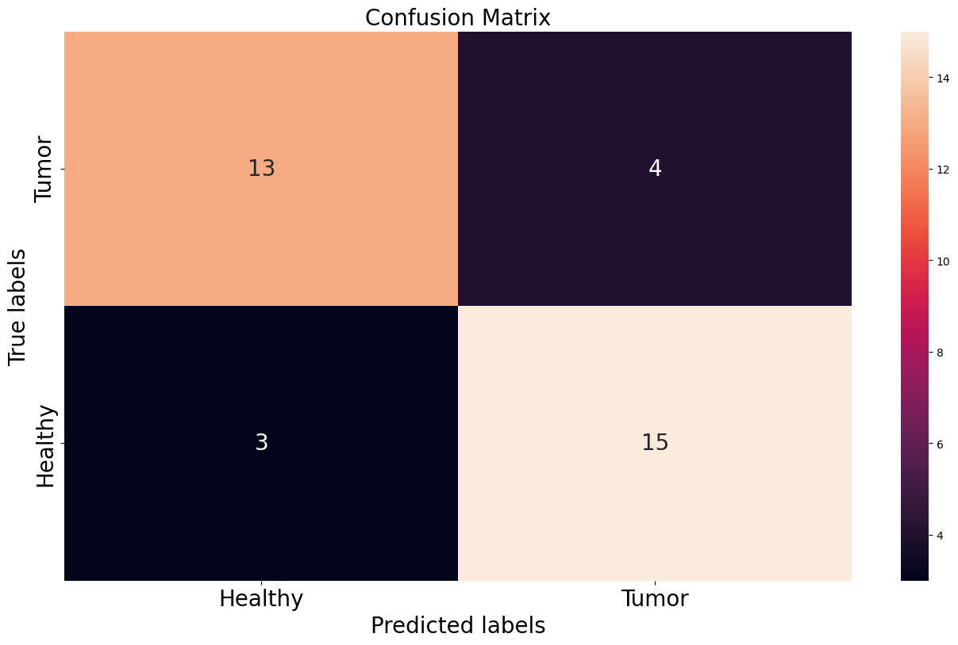
Confusion Matrix
Notes:
5

Slide 7

Notes:
4

